Slide 1


AVR Assembly Language Programming Chapter 2 (pp 75 - 79)
The AVR microcontroller
and embedded
systems
using assembly and c

Slide 2
The AVR Assembler
We use the AVRASM2 assembler that comes with AVR studio
The Assembler performs the conversion from English mnemonics to opcodes that are programmed into the microcontroller
C compilers generate assembly language mnemonics that are then assembled by an assembler
Much confusion arises when one does not have a conceptual understanding of the different assembly phases

Slide 3
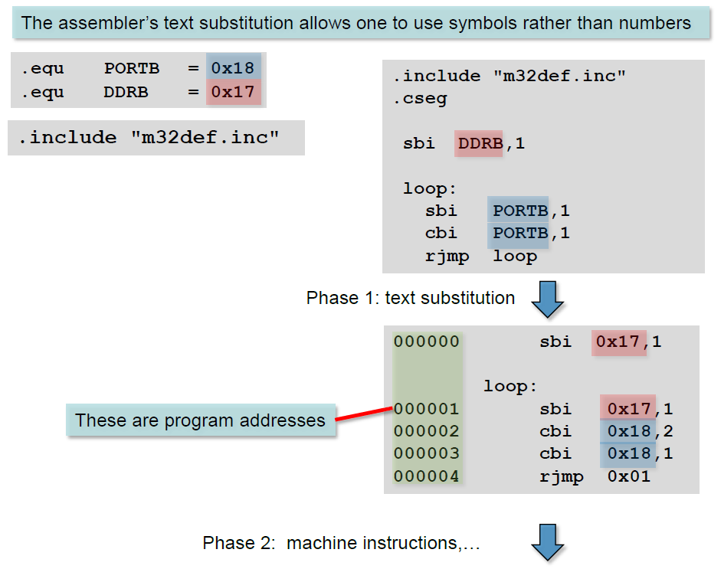

Slide 4
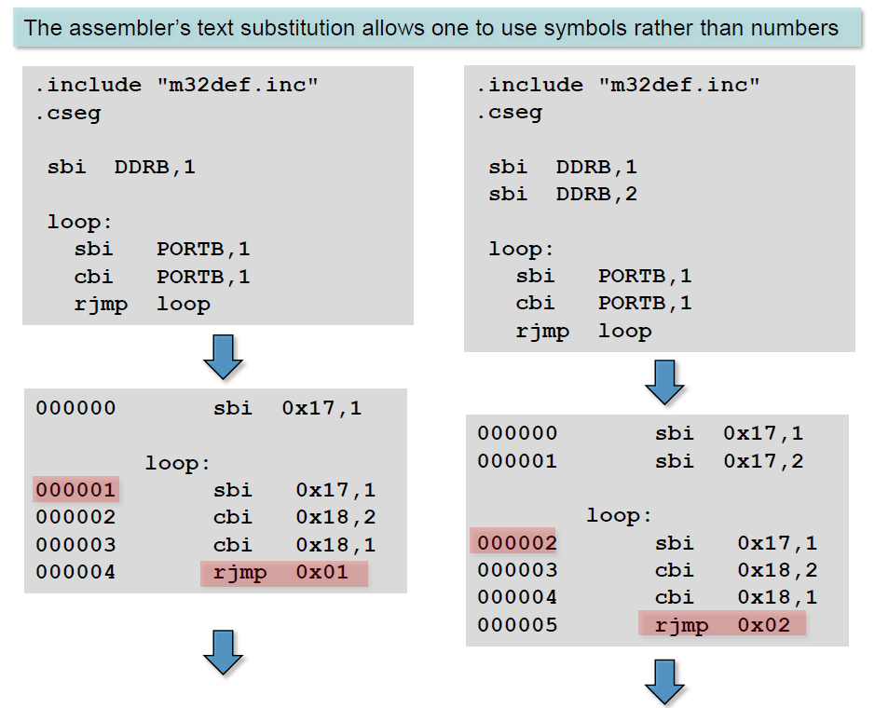

Slide 5
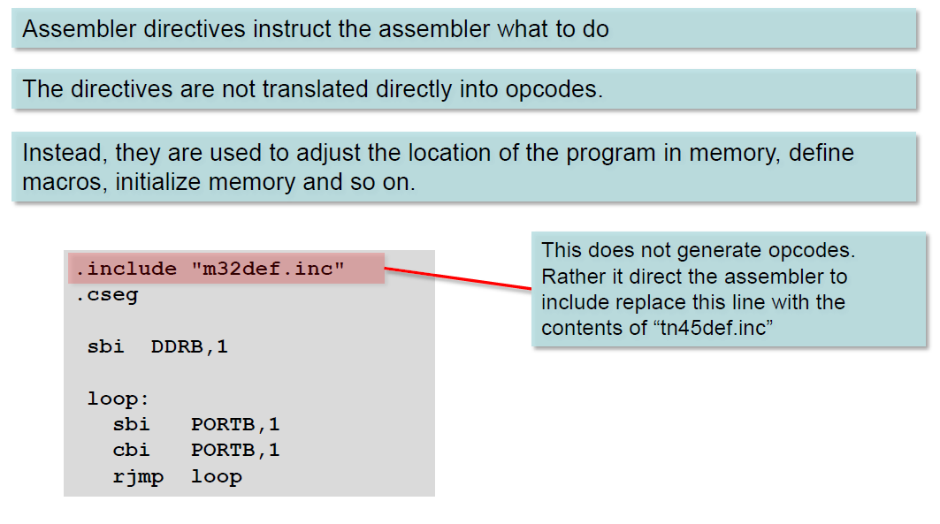
Assembler Directives

Slide 6
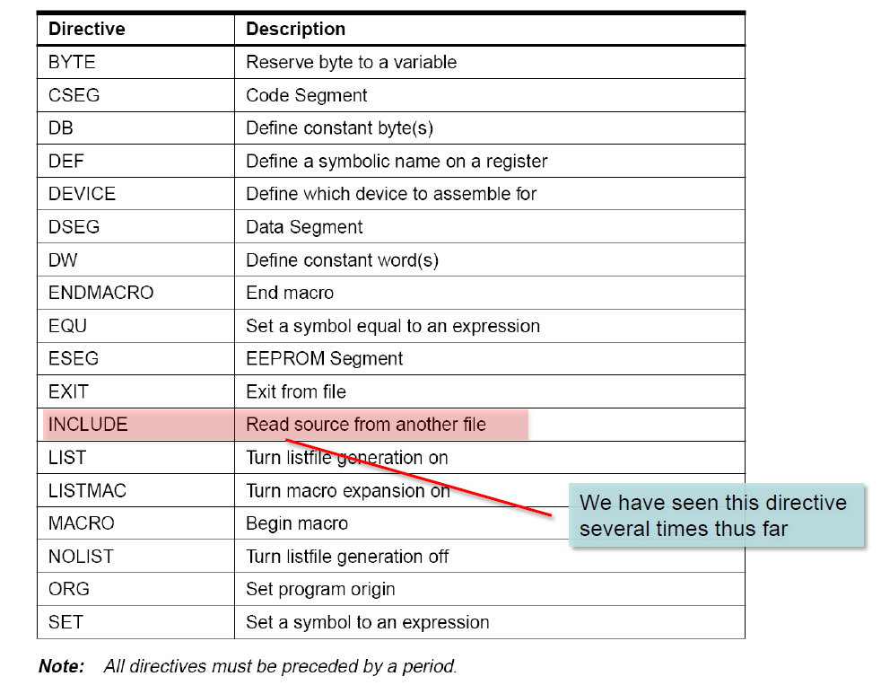
Assembler Directives

Slide 7
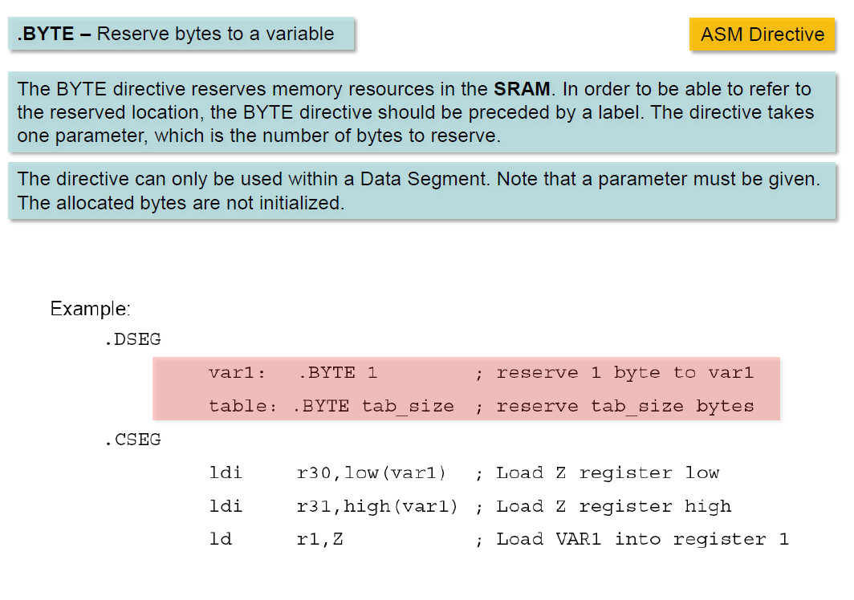

Slide 8
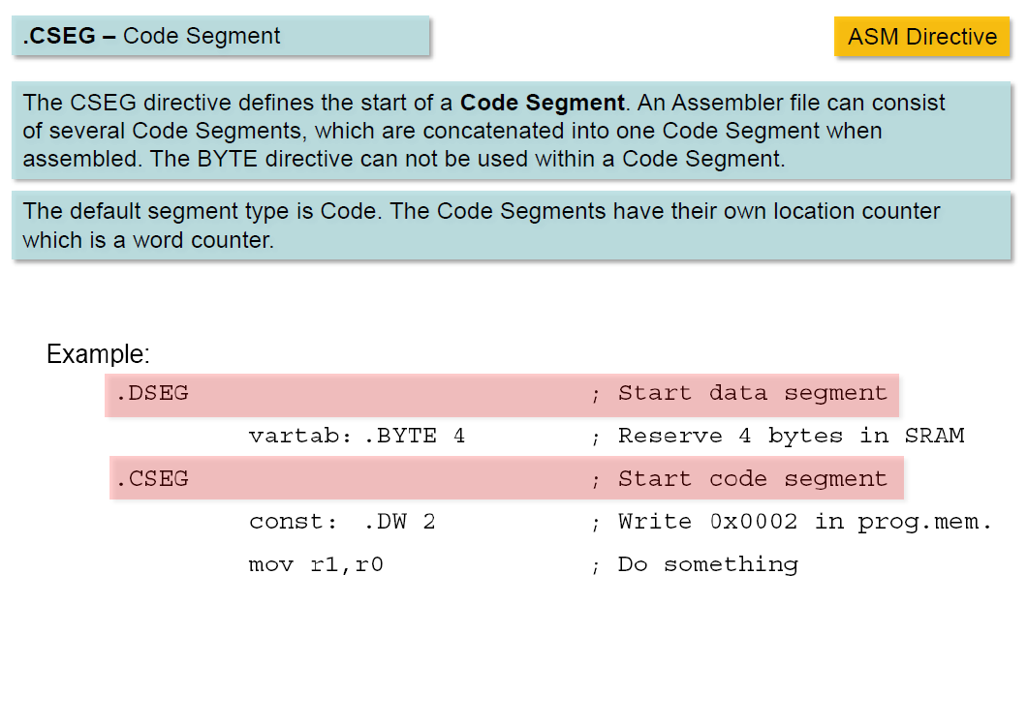

Slide 9
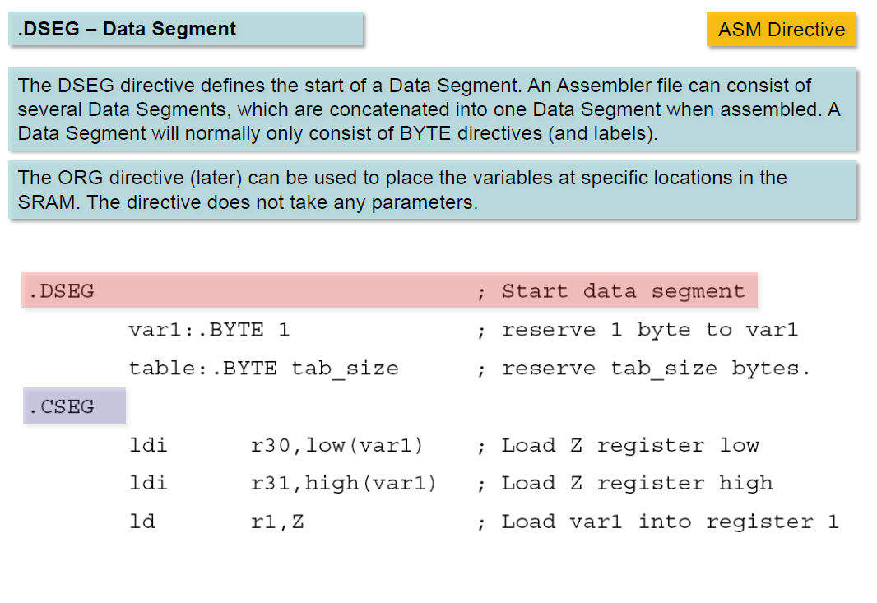

Slide 10
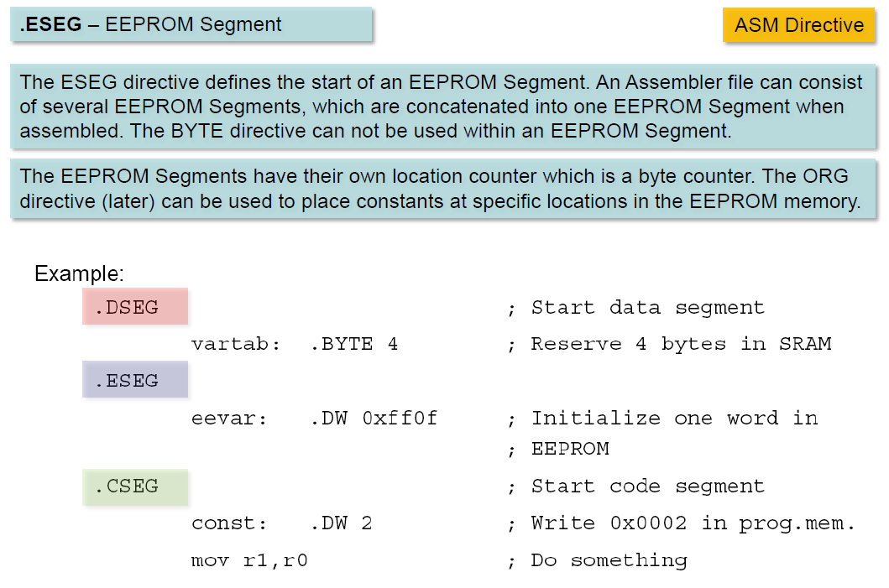

Slide 11
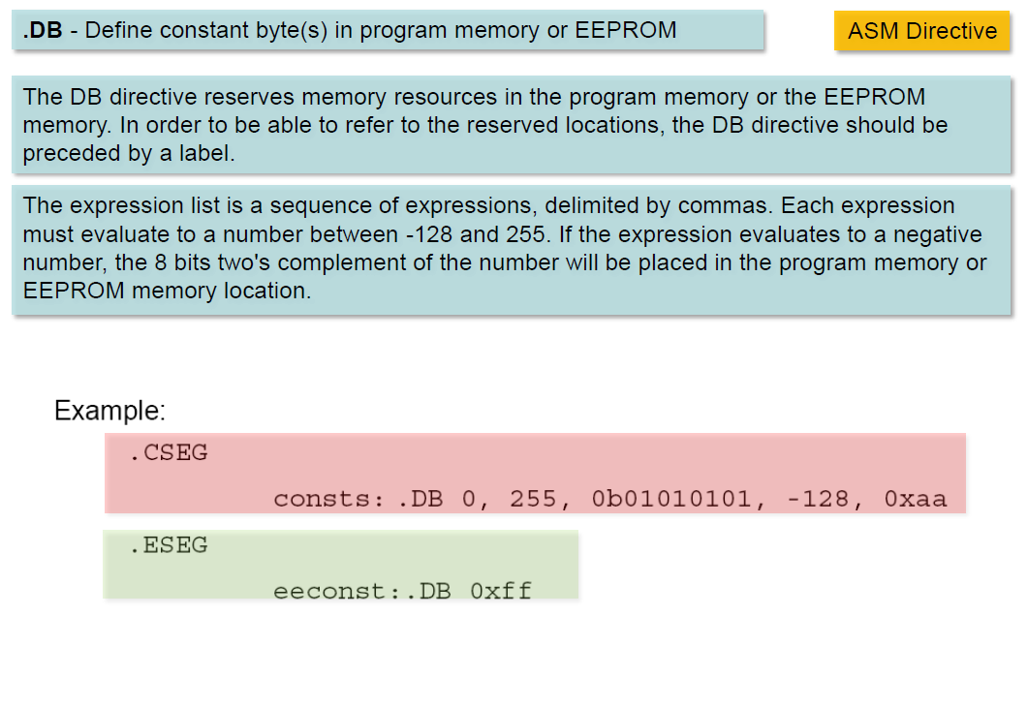

Slide 12
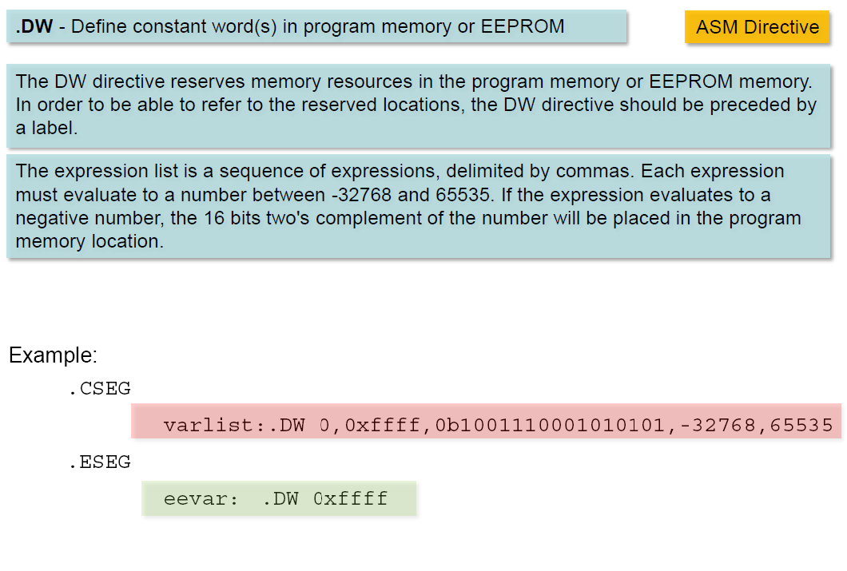

Slide 13
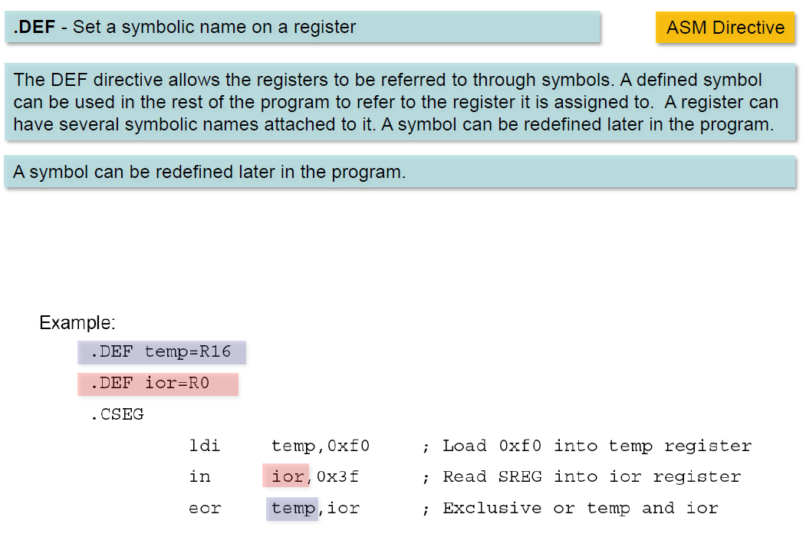

Slide 14
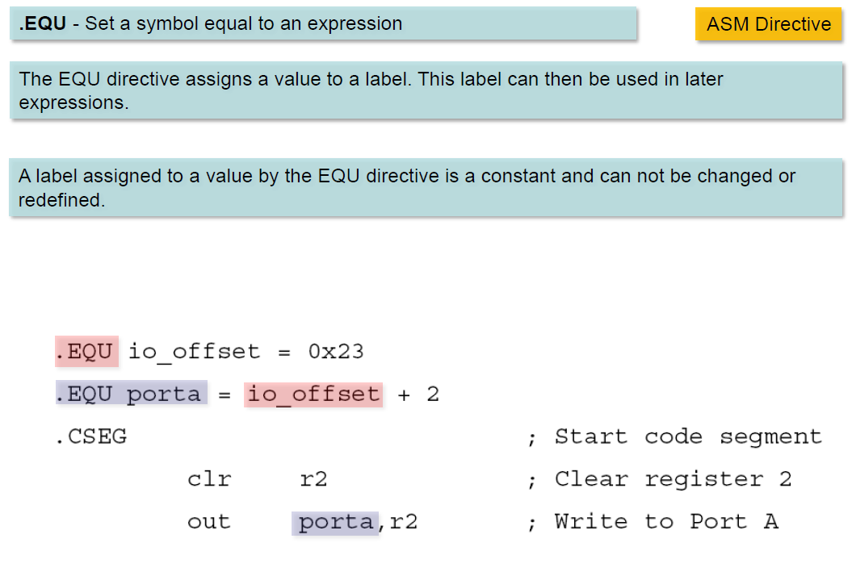

Slide 15
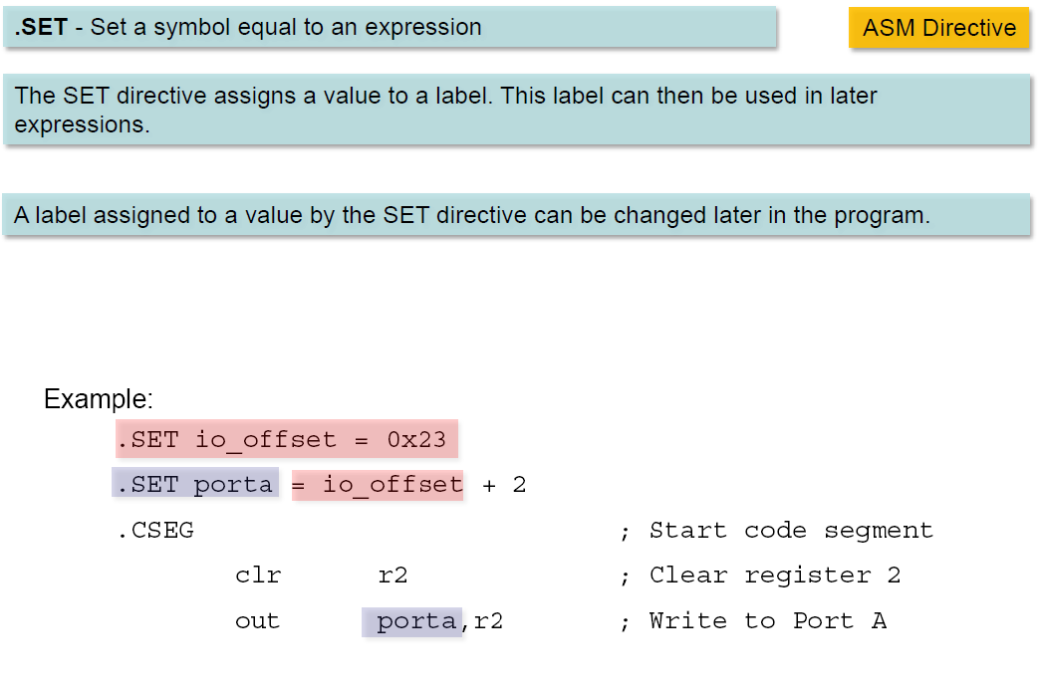

Slide 16
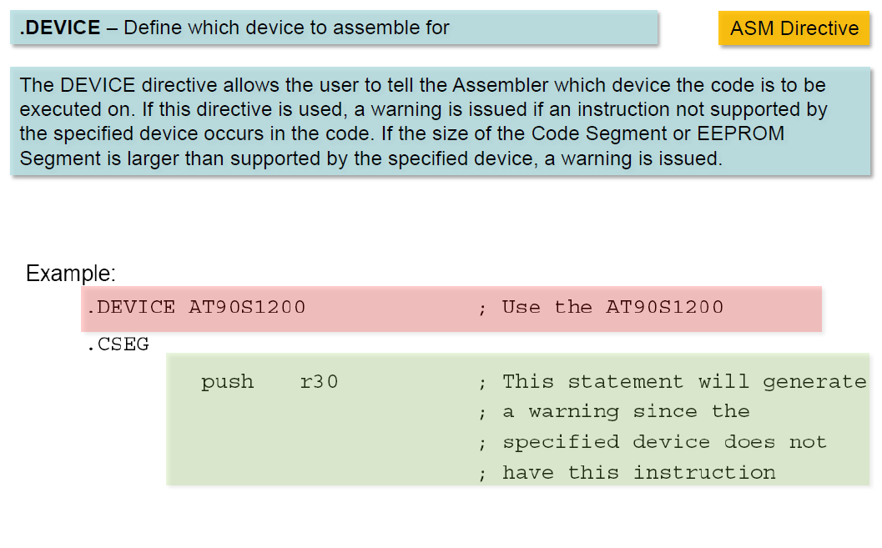

Slide 17
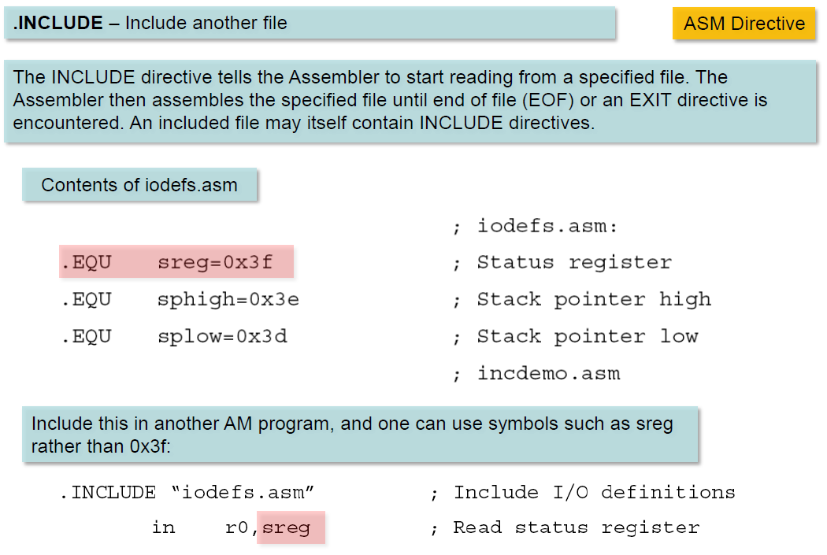

Slide 18
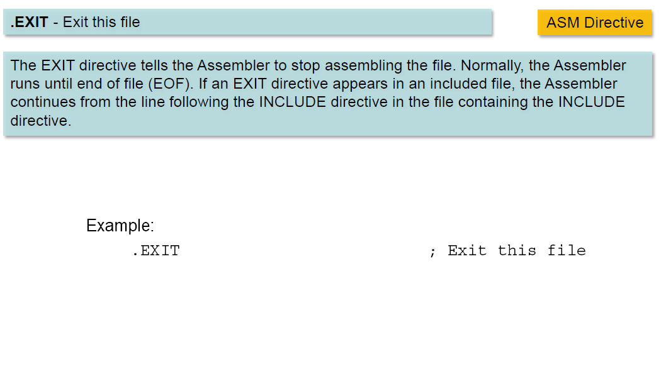

Slide 19
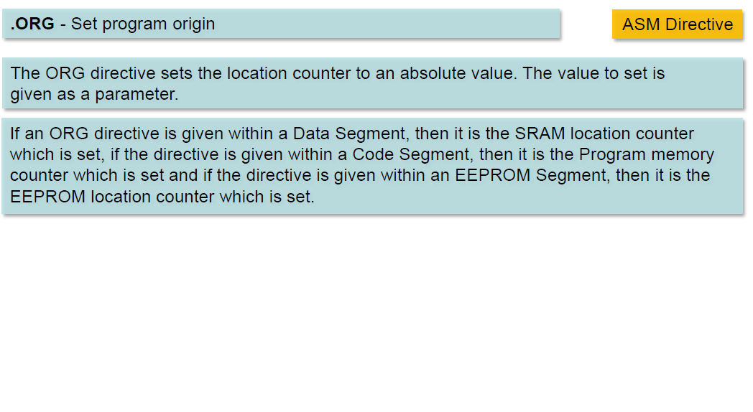

Slide 20
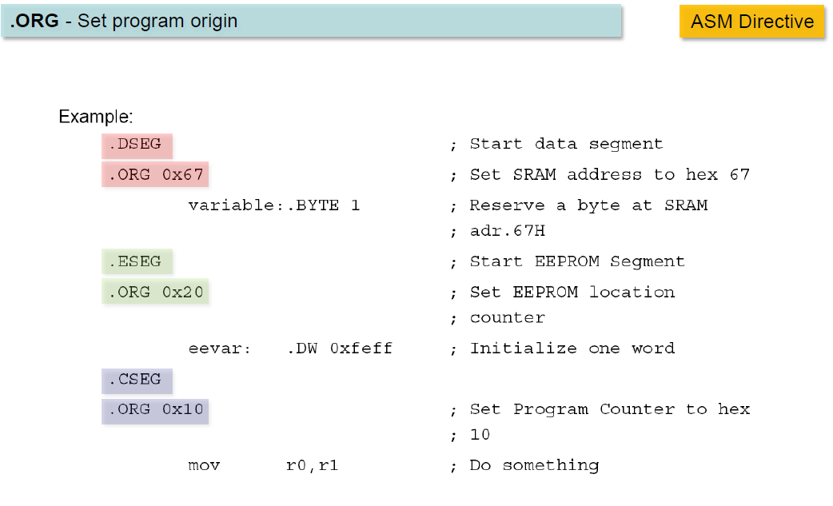

Slide 21
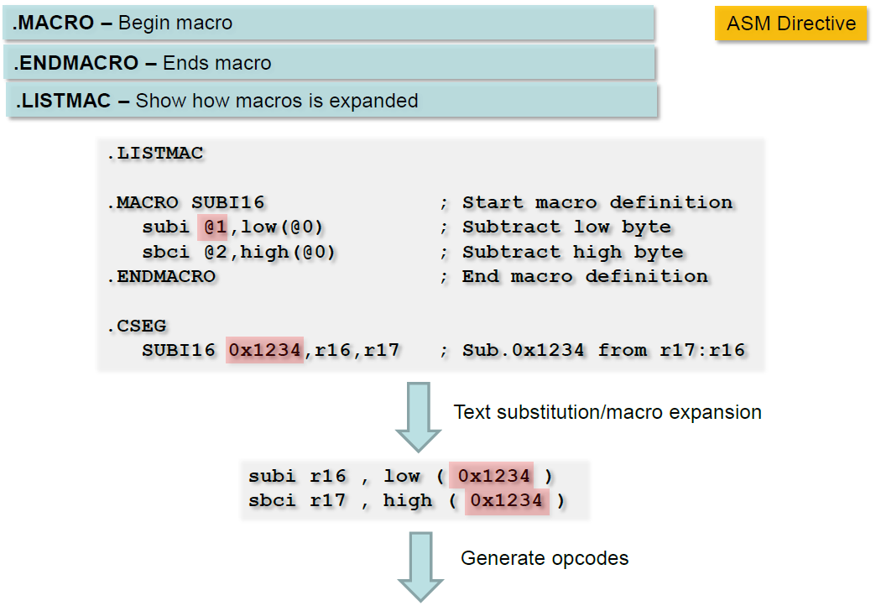

Slide 22
Assembler Directives .EQU and .SET
.EQU name = value
Example:
.EQU COUNT = 0x25
LDI R21, COUNT ;R21 = 0x25
LDI R22, COUNT + 3 ;R22 = 0x28
.SET name = value
Example:
.SET COUNT = 0x25
LDI R21, COUNT ;R21 = 0x25
LDI R22, COUNT + 3 ;R22 = 0x28
.SET COUNT = 0x19
LDI R21, COUNT ;R21 = 0x19

Slide 23
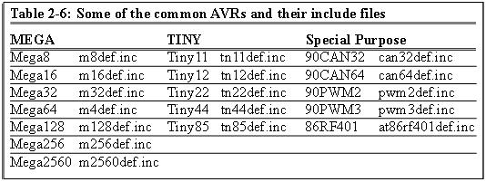
Assembler Directives .INCLUDE
.INCLUDE "filename.ext"
M32def.inc
.equ SREG = 0x3f
.equ SPL = 0x3d
.equ SPH = 0x3e
....
.equ INT_VECTORS_SIZE = 42 ; size in words
Program.asm
.INCLUDE "M32DEF.INC"
LDI R20, 10
OUT SPL, R20

Slide 24
Assembler Directives .ORG
.ORG address
00 E205
01 0000
02 0000
03 0000
04 0000
05 0000
06 0000
07 E314
08 E321
09 0000
0A 0000
Program.asm
.ORG 0
LDI R16, 0x25
.ORG 0x7
LDI R17, 0x34
LDI R18, 0x31
assembler

Slide 25
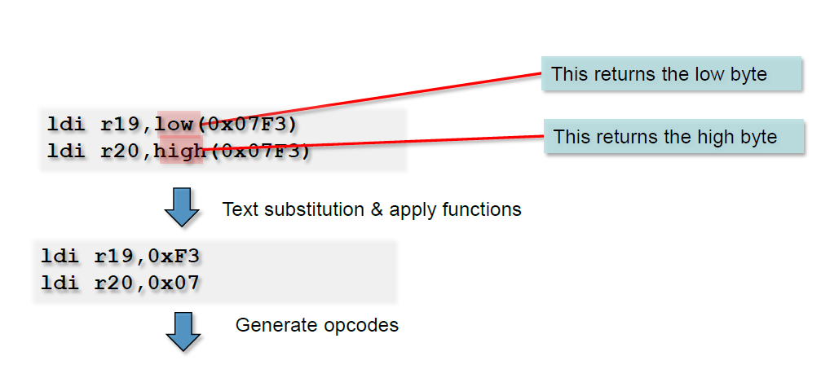
Assembler Functions

Slide 26
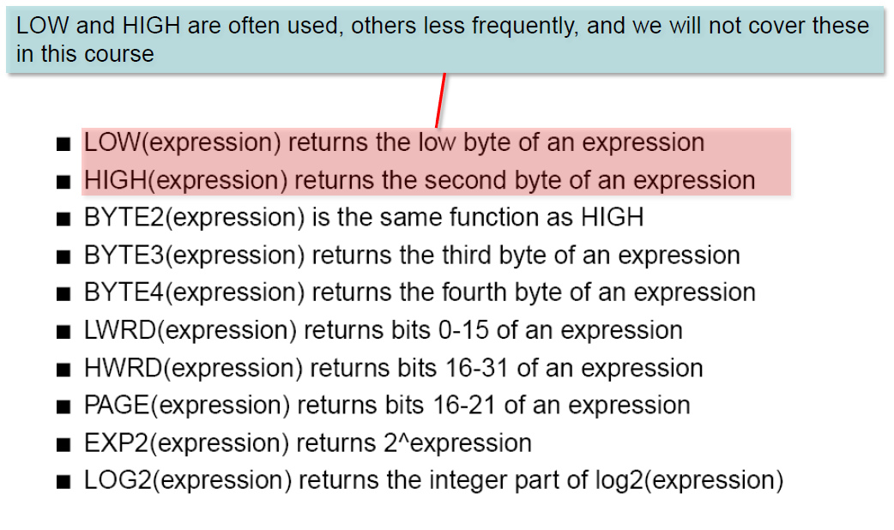
Assembler Functions

Slide 27
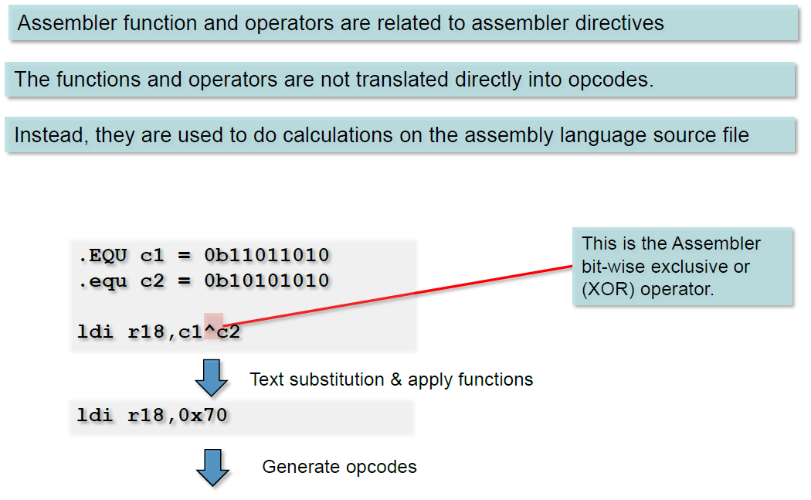
Assembler Operators

Slide 28
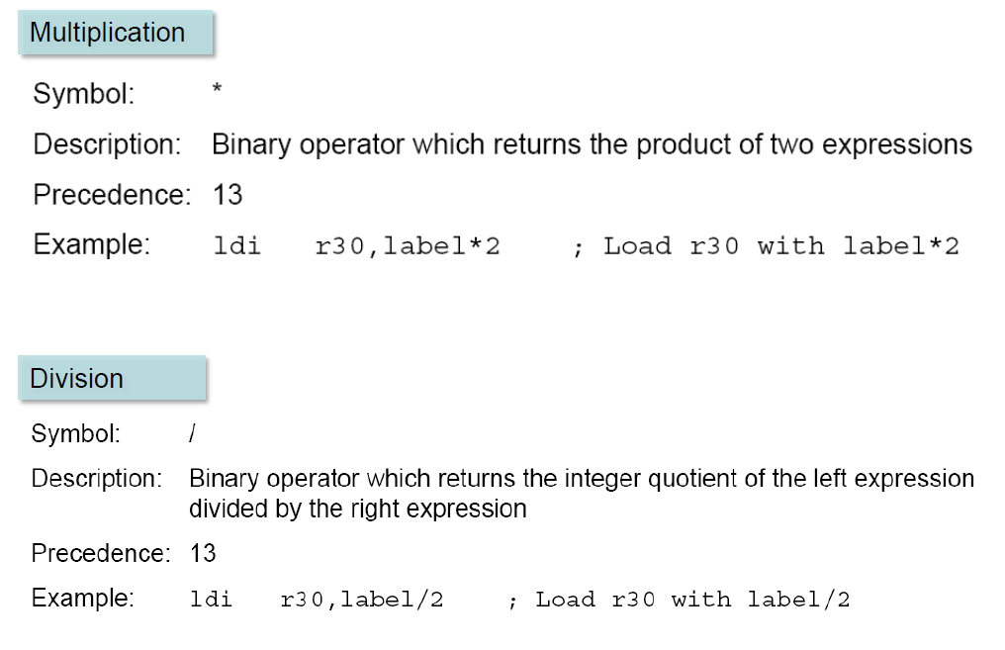
Some Assembler Operators

Slide 29
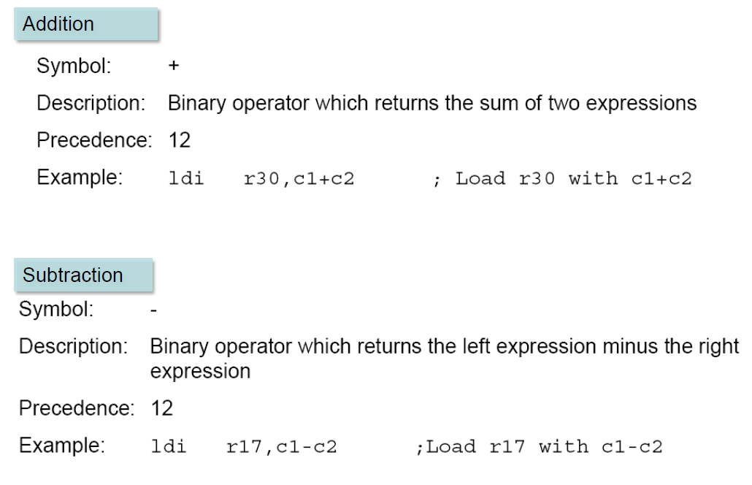
Some Assembler Operators

Slide 30
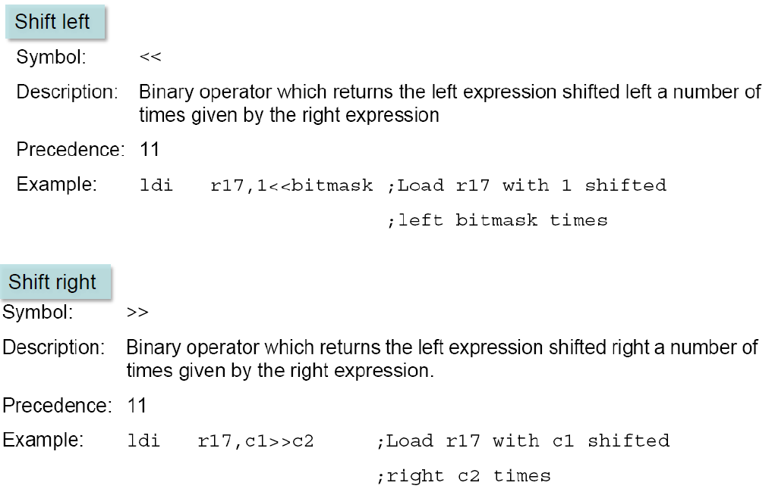
Some Assembler Operators

Slide 31
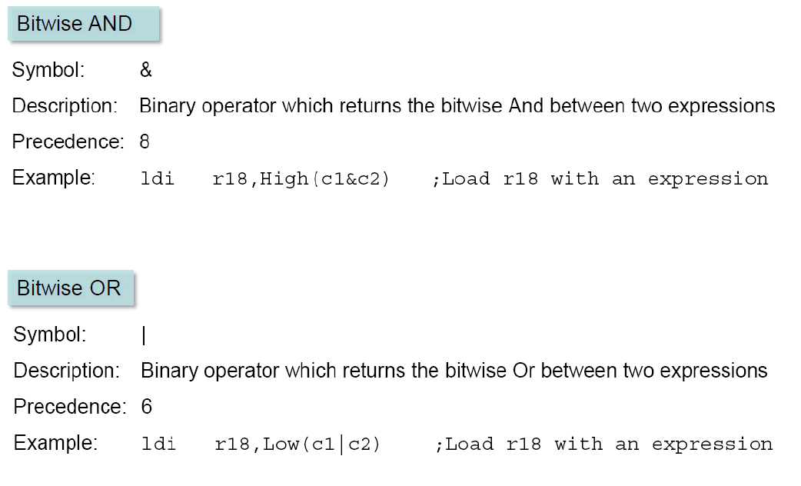
Some Assembler Operators

Slide 32
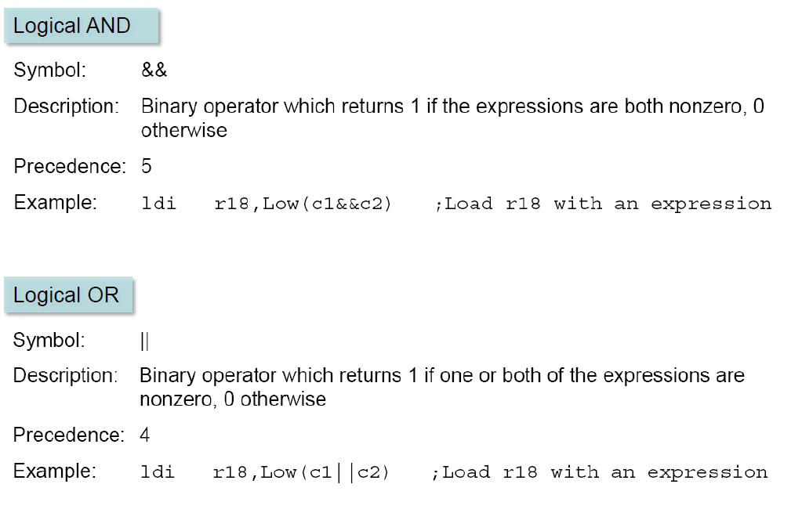
Some Assembler Operators

Slide 33
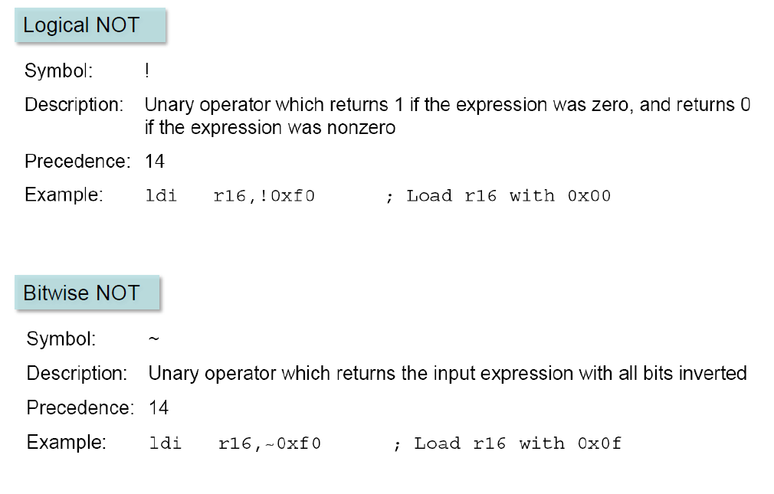
Some Assembler Operators

Slide 34
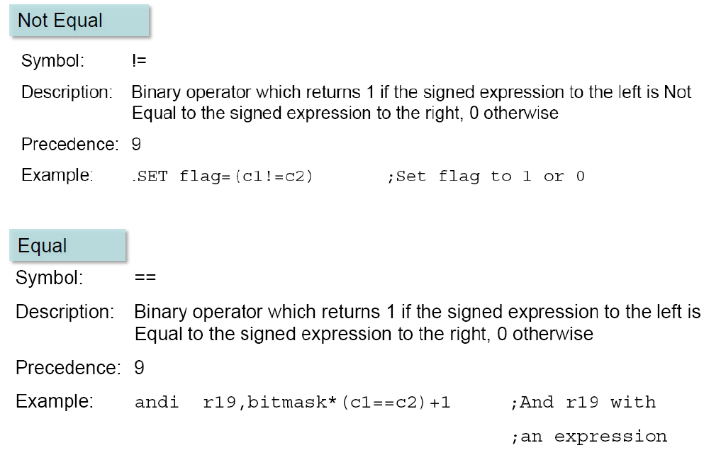
Some Assembler Operators

Slide 35
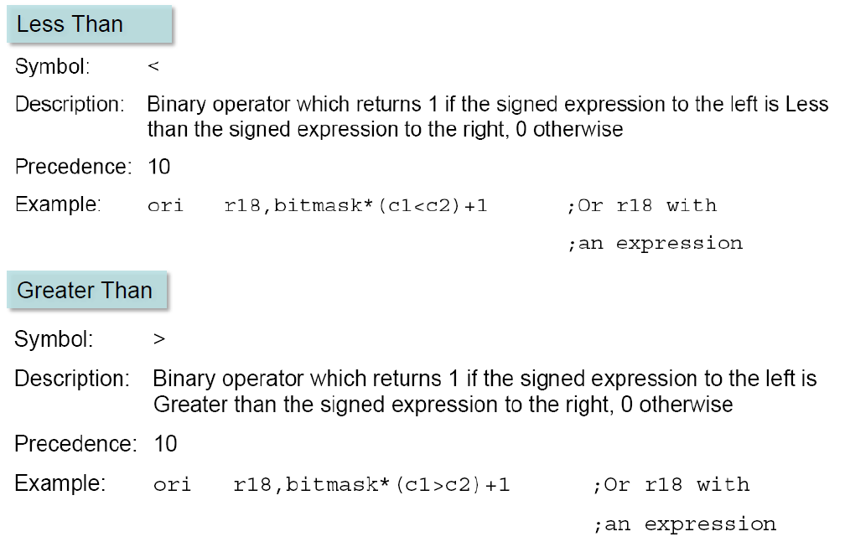
Some Assembler Operators

Slide 36
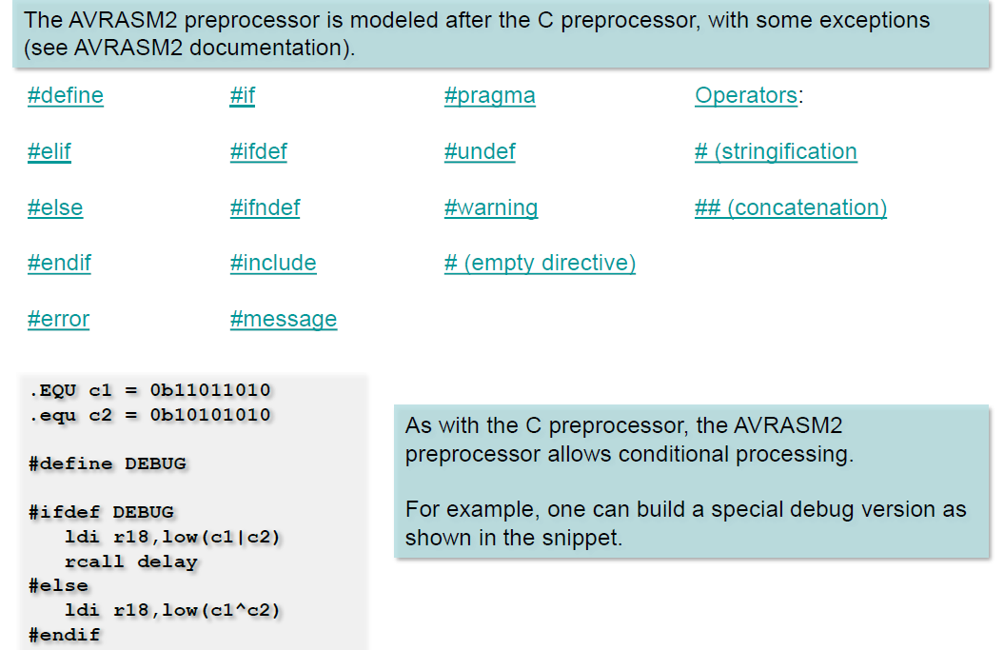
Assembler Preprocessor

Slide 37
Assembler
Assembly
assembler
Machine
Language

Slide 38
Flash memory and PC register
LDI R16, 0x25
LDI R17, $34
LDI R18, 0x31
ADD R16, R17
ADD R16, R18
LDI R17, 11
ADD R16, R17
STS SUM, R16
HERE:JMP HERE
00 E205
01 E314
02 E321
03 0F01
04 0F02
05 E01B
06 0F01
07 9300
08 0300
09 940C
0A 0009
E205
E314
E321
0F01
0F02
16-bit
E01B
0F01
9300
0300
940C
0009
3
0
9
1
5
2
7
A
4
8
B
6

Slide 39
Fetch and execute
Old Architectures
00 E205
01 E314
02 E321
03 0F01
04 0F02
05 E01B
06 0F01
07 9300
08 0300
09 940C
0A 0009
Instruct 4
Instruct 3
Instruct 2
Instruct 1
16-bit
Fetch
Execute

Slide 40
Pipelining
Pipelining
00 E205
01 E314
02 E321
03 0F01
04 0F02
05 E01B
06 0F01
07 9300
08 0300
09 940C
0A 0009
Instruct 4
Instruct 3
Instruct 2
16-bit
Instruct 1
Fetch
Execute

Slide 41
How to speed up the CPU
Increase the clock frequency
More frequency ➔ More power consumption & more heat
Limitations
Change the architecture
Pipelining
RISC

Slide 42
Changing the architecture RISC vs. CISC
CISC (Complex Instruction Set Computer)
Put as many instruction as you can into the CPU
RISC (Reduced Instruction Set Computer)
Reduce the number of instructions, and use your facilities in a more proper way.

Slide 43
RISC architecture
Feature 1
RISC processors have a fixed instruction size. It makes the task of instruction decoder easier.
In AVR the instructions are 2 or 4 bytes.
In CISC processors instructions have different lengths
E.g. in 8051
CLR C ; a 1-byte instruction
ADD A, #20H ; a 2-byte instruction
LJMP HERE ; a 3-byte instruction

Slide 44
RISC architecture
Feature 2: reduce the number of instructions
Pros: Reduces the number of used transistors
Cons:
Can make the assembly programming more difficult
Can lead to using more memory

Slide 45
RISC architecture
Feature 3: limit the addressing mode
Advantage
hardwiring
Disadvantage
Can make the assembly programming more difficult

Slide 46
RISC architecture
Feature 4: Load/Store
LDS R20, 0x200
LDS R21, 0x220
ADD R20, R21
STS 0x230, R20

Slide 47
RISC architecture
Feature 5 (Harvard architecture): separate buses for opcodes and operands
Advantage: opcodes and operands can go in and out of the CPU together.
Disadvantage: leads to more cost in general purpose computers.
LDS R20, 0x100 ; R20 = [0x100]
ADD R20,R21 ; R20 = R20 + R21
ADD R20, R21
LDS R20, 0x100
Fetch
Execute
CPU
Code
Memory
Control bus
Control bus
Data
Memory
Data bus
Data bus
Address bus
Address bus

Slide 48
RISC architecture
Feature 6: more than 95% of instructions are executed in 1 machine cycle

Slide 49
RISC architecture
Feature 7
RISC processors have at least 32 registers. Decreases the need for stack and memory usages.
In AVR there are 32 general purpose registers (R0 to R31)

Slide 50
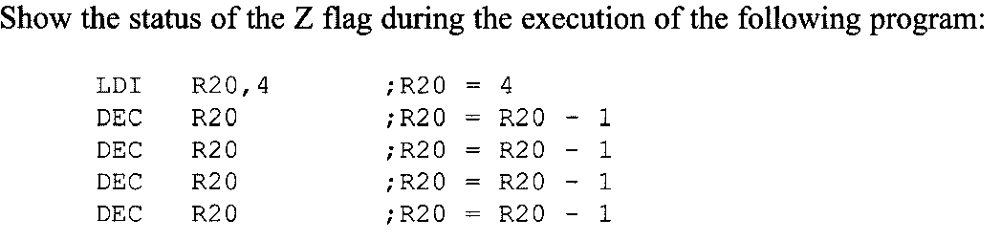
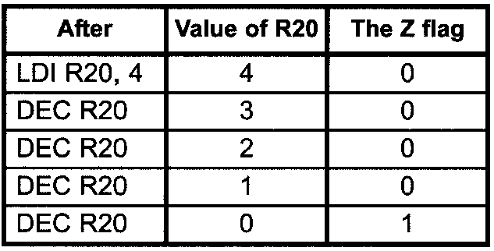
Example 2-5
Write the program in AVR Studio to verify that The Z flag is the one when the result is zero. Verify:
Note: do not forget to add iat the beginning of the program:
.include "M32DEF.inc"

Slide 51
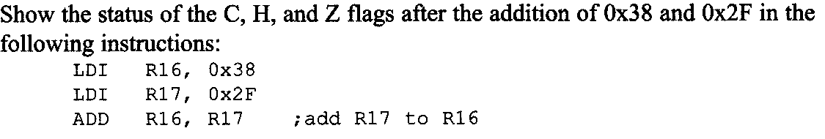
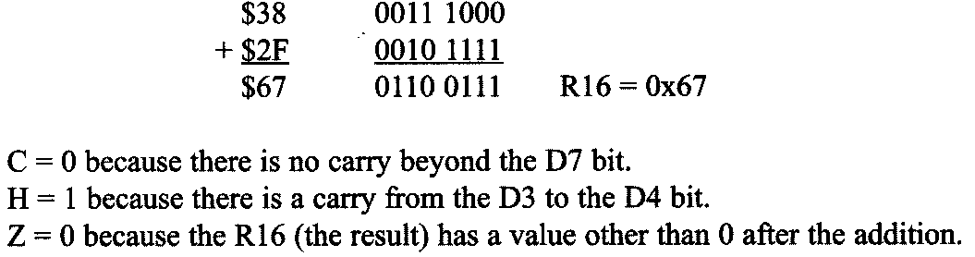
Example 2- 6
Verify using AVR Studio

Slide 52
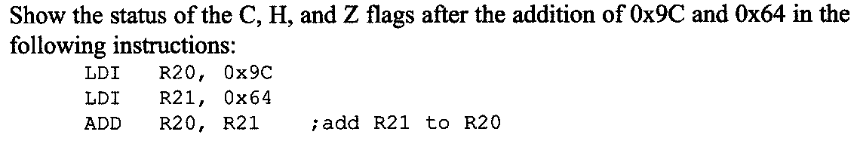
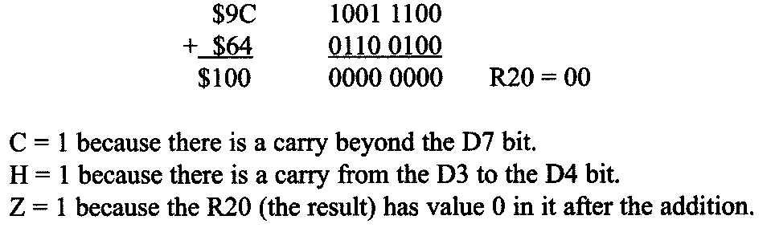
Example 2- 7
Verify using AVR Studio

Slide 53
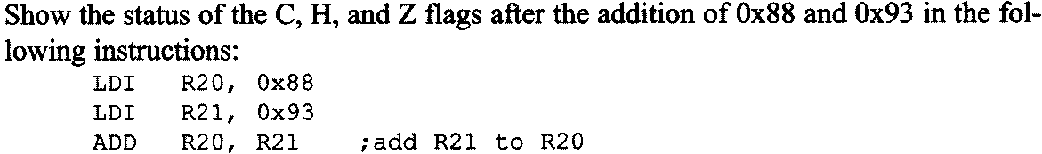
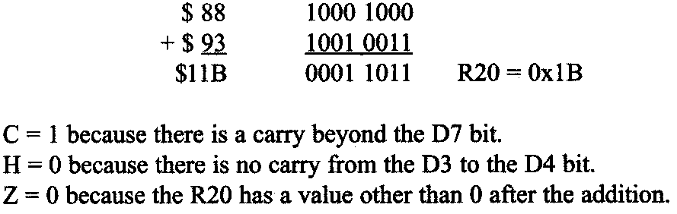
Example 2- 8
Verify using AVR Studio

Slide 54
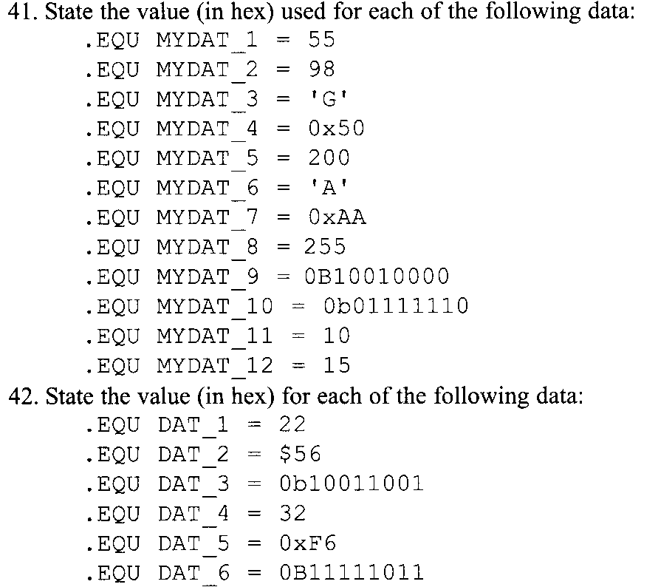
Problems (5)

Slide 55
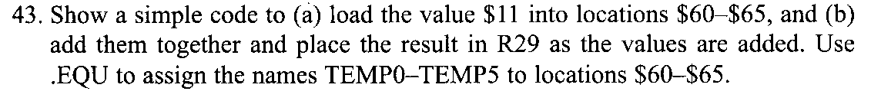
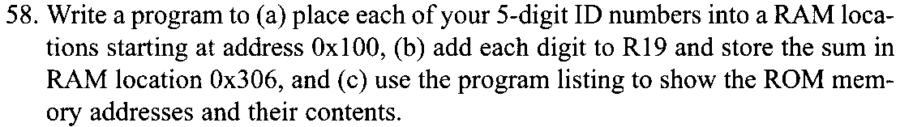
Programming Exercise

Slide 56
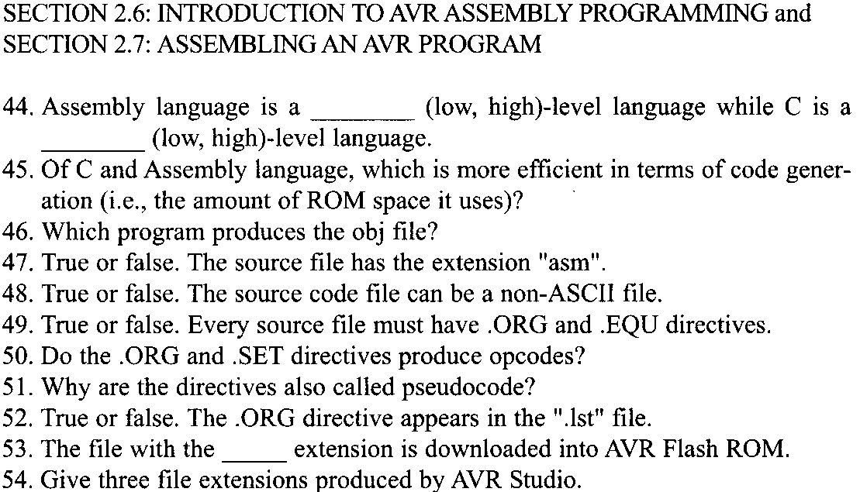
Problems (6)

Slide 57
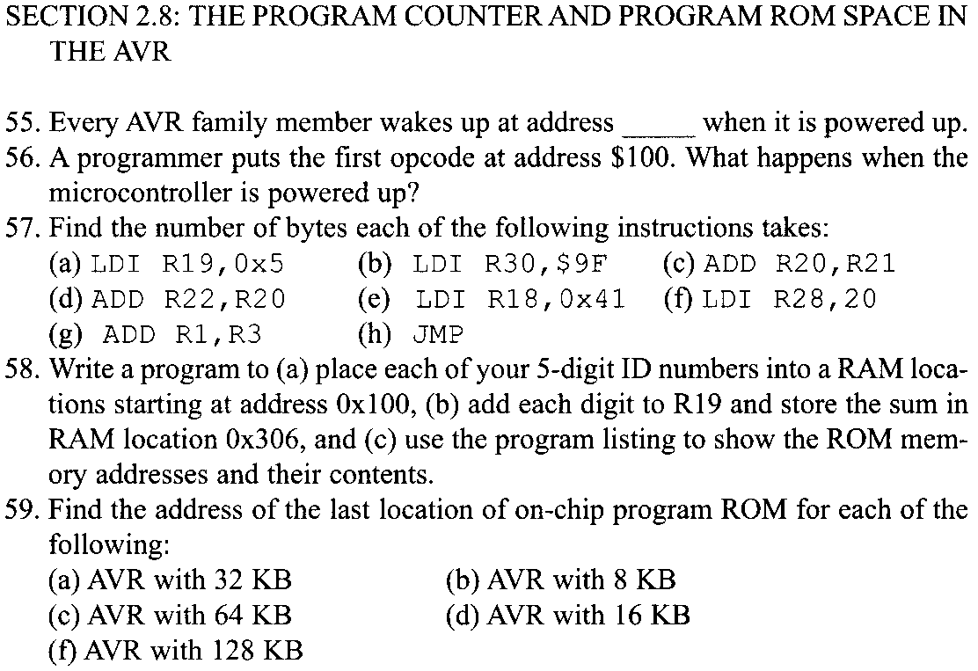
Problem (7)

Slide 58
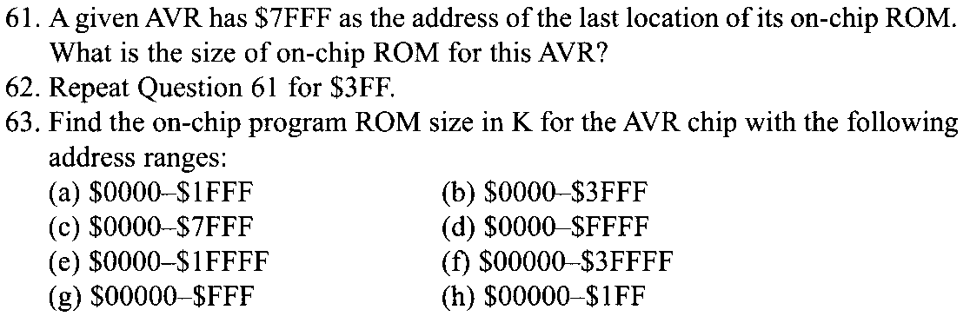
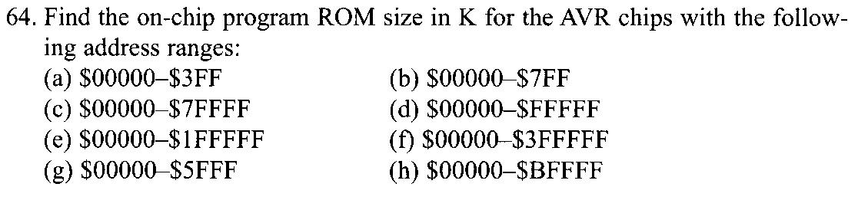
Problem (8)

